Slide 1

project for Software engineering Course 2018/19
Notes:
Typical intro

Slide 2
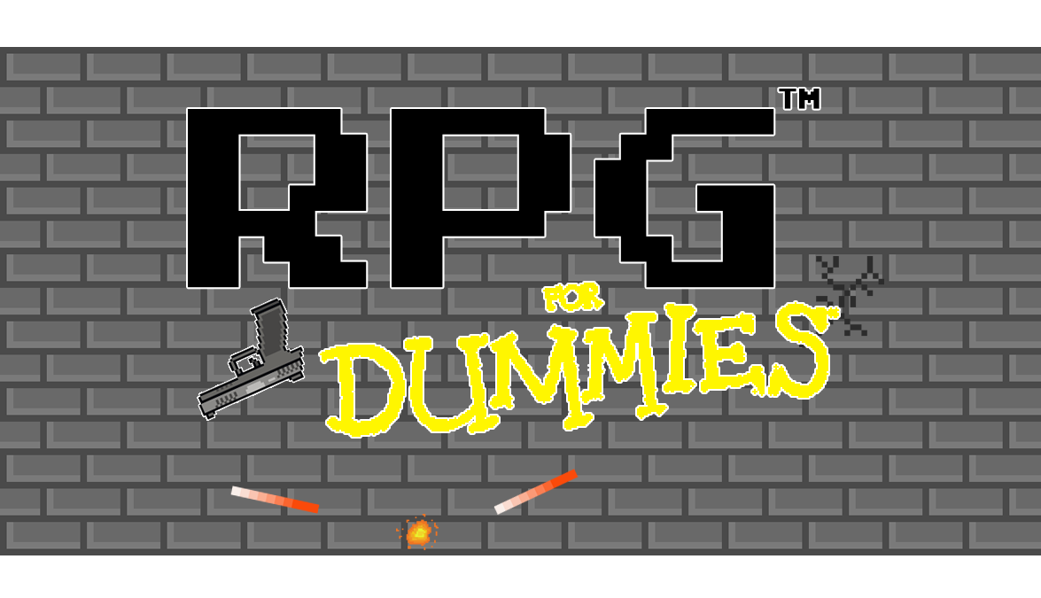
Notes:
Auto-explain

Slide 3
Group components:
Fernando Manna
Giovanni Di Prisco
Marco Schettini
Mario Mupo
Sergio Siniscalchi
Ascanio Guglielmelli
Romeo Rinaldi
Notes:
Group organization

Slide 4
User Stories
ID | TYPE | User Story | Story Points | Priority
1 | START MENU | As a player, I want a main menu, so I can start the game or set options. | 2 | 1
2 | START MENU | As a player, I want to set the character’s name so I can identify it. | 2 | 1
3 | MAIN ROOM | As a player, I want to use the keyboard so I can move or shoot freely into the scenario. | 21 | 3
4 | MAIN ROOM | As a player, I want a storage so I can collect items. | 8 | 2
5 | MAIN ROOM | As a player, I want to have stats for my character so I can have some information about him. | 5 | 2
6 | MAIN ROOM | As a player, I want to equip items so I can improve character’s stats. | 5 | 2
7 | MAIN ROOM | As a player, I want a crafting method so I can improve item’s stats. | 13 | 1
8 | MAIN ROOM | As a player, I want some different play-styles so I can choose which one to play. | 21 | 2
9 | MAIN ROOM | As a player, I want to save my progresses so I can resume the game. | 13 | 1
10 | MODE ROOM | As a player, I want random generated maps so I can have different scenery. | 13 | 2
11 | MODE ROOM | As a player, I want enemies in the scenery so I can have a challenging experience. | 13 | 3
12 | MODE ROOM | As a player, I want a goal for each scenario so I can go to the next one. | 2 | 2
13 | MODE ROOM | As a player, I want an increasing difficulty so I can have enemies at my same level. | 8 | 1
14 | MODE ROOM | As a player, I want to test my abilities so I can choose different among difficulty levels. | 2 | 1
15 | MODE ROOM | As a player, I want an interface so I can see my stats and equipped items. | 5 | 1

Slide 5
Daily Sprints
 | USER STORY | TASK | IN PROGRESS | TESTING | DONE | HP
3 | move & shot | code character class |  |  |  | 3
 |  | implement moving with action listeners of keyboard |  |  |  | 8
 |  | code shoot class |  |  |  | 2
 |  | implement shooting with action listeners of keyboard |  |  |  | 5
 |  | Design character |  |  |  | 1
 |  | Design shot |  |  |  | 2
 | TOTAL |  |  |  |  | 21
11 | enemies | code mob class |  |  |  | 3
 |  | implement collision between character and mobs |  |  |  | 3
 |  | implement collision between character's shot and mobs |  |  |  | 3
 |  | implement collision between mob's shot and character |  |  |  | 3
 |  | Design Mob |  |  |  | 1
 | TOTAL |  |  |  |  | 13
10 | Random maps | code map generator class |  |  |  | 3
 |  | implements function that generates map randomly |  |  |  | 8
 |  | Design map element |  |  |  | 2
 | TOTAL |  |  |  |  | 13
 | TOTAL STORY POINT |  |  |  |  | 47
 | TOTAL STORY POINT ACQUIRED

Slide 6
Daily Sprints
 | USER STORY | TASK | IN PROGRESS | TESTING | DONE | HP
3 | move & shot | code character class |  |  |  | 3
 |  | implement moving with action listeners of keyboard |  |  |  | 8
 |  | code shoot class |  |  |  | 2
 |  | implement shooting with action listeners of keyboard |  |  |  | 5
 |  | Design character |  |  |  | 1
 |  | Design shot |  |  |  | 2
 | TOTAL |  |  |  |  | 21
11 | enemies | code mob class |  |  |  | 3
 |  | implement collision between character and mobs |  |  |  | 3
 |  | implement collision between character's shot and mobs |  |  |  | 3
 |  | implement collision between mob's shot and character |  |  |  | 3
 |  | Design Mob |  |  |  | 1
 | TOTAL |  |  |  |  | 13
10 | Random maps | code map generator class |  |  |  | 3
 |  | implements function that generates map randomly |  |  |  | 8
 |  | Design map element |  |  |  | 2
 | TOTAL |  |  |  |  | 13
 | TOTAL STORY POINT |  |  |  |  | 47
 | TOTAL STORY POINT ACQUIRED

Slide 7
Daily Sprints
 | USER STORY | TASK | IN PROGRESS | TESTING | DONE | HP
3 | move & shot | code character class |  |  |  | 3
 |  | implement moving with action listeners of keyboard |  |  |  | 8
 |  | code shoot class |  |  |  | 2
 |  | implement shooting with action listeners of keyboard |  |  |  | 5
 |  | Design character |  |  |  | 1
 |  | Design shot |  |  |  | 2
 | TOTAL |  |  |  |  | 21
11 | enemies | code mob class |  |  |  | 3
 |  | implement collision between character and mobs |  |  |  | 3
 |  | implement collision between character's shot and mobs |  |  |  | 3
 |  | implement collision between mob's shot and character |  |  |  | 3
 |  | Design Mob |  |  |  | 1
 | TOTAL |  |  |  |  | 13
10 | Random maps | code map generator class |  |  |  | 3
 |  | implements function that generates map randomly |  |  |  | 8
 |  | Design map element |  |  |  | 2
 | TOTAL |  |  |  |  | 13
 | TOTAL STORY POINT |  |  |  |  | 47
 | TOTAL STORY POINT ACQUIRED

Slide 8
Daily Sprints
 | USER STORY | TASK | IN PROGRESS | TESTING | DONE | HP
3 | move & shot | code character class |  |  |  | 3
 |  | implement moving with action listeners of keyboard |  |  |  | 8
 |  | code shoot class |  |  |  | 2
 |  | implement shooting with action listeners of keyboard |  |  |  | 5
 |  | Design character |  |  |  | 1
 |  | Design shot |  |  |  | 2
 | TOTAL |  |  |  |  | 21
11 | enemies | code mob class |  |  |  | 3
 |  | implement collision between character and mobs |  |  |  | 3
 |  | implement collision between character's shot and mobs |  |  |  | 3
 |  | implement collision between mob's shot and character |  |  |  | 3
 |  | Design Mob |  |  |  | 1
 | TOTAL |  |  |  |  | 13
10 | Random maps | code map generator class |  |  |  | 3
 |  | implements function that generates map randomly |  |  |  | 8
 |  | Design map element |  |  |  | 2
 | TOTAL |  |  |  |  | 13
 | TOTAL STORY POINT |  |  |  |  | 47
 | TOTAL STORY POINT ACQUIRED

Slide 9
Daily Sprints
 | USER STORY | TASK | IN PROGRESS | TESTING | DONE | HP
3 | move & shot | code character class |  |  |  | 3
 |  | implement moving with action listeners of keyboard |  |  |  | 8
 |  | code shoot class |  |  |  | 2
 |  | implement shooting with action listeners of keyboard |  |  |  | 5
 |  | Design character |  |  |  | 1
 |  | Design shot |  |  |  | 2
 | TOTAL |  |  |  |  | 21
11 | enemies | code mob class |  |  |  | 3
 |  | implement collision between character and mobs |  |  |  | 3
 |  | implement collision between character's shot and mobs |  |  |  | 3
 |  | implement collision between mob's shot and character |  |  |  | 3
 |  | Design Mob |  |  |  | 1
 | TOTAL |  |  |  |  | 13
10 | Random maps | code map generator class |  |  |  | 3
 |  | implements function that generates map randomly |  |  |  | 8
 |  | Design map element |  |  |  | 2
 | TOTAL |  |  |  |  | 13
 | TOTAL STORY POINT |  |  |  |  | 47
 | TOTAL STORY POINT ACQUIRED

Slide 10
Daily Sprints
 | USER STORY | TASK | IN PROGRESS | TESTING | DONE | HP
3 | move & shot | code character class |  |  |  | 3
 |  | implement moving with action listeners of keyboard |  |  |  | 8
 |  | code shoot class |  |  |  | 2
 |  | implement shooting with action listeners of keyboard |  |  |  | 5
 |  | Design character |  |  |  | 1
 |  | Design shot |  |  |  | 2
 | TOTAL |  |  |  |  | 21
11 | enemies | code mob class |  |  |  | 3
 |  | implement collision between character and mobs |  |  |  | 3
 |  | implement collision between character's shot and mobs |  |  |  | 3
 |  | implement collision between mob's shot and character |  |  |  | 3
 |  | Design Mob |  |  |  | 1
 | TOTAL |  |  |  |  | 13
10 | Random maps | code map generator class |  |  |  | 3
 |  | implements function that generates map randomly |  |  |  | 8
 |  | Design map element |  |  |  | 2
 | TOTAL |  |  |  |  | 13
 | TOTAL STORY POINT |  |  |  |  | 47
 | TOTAL STORY POINT ACQUIRED

Slide 11
Daily Sprints
 | USER STORY | TASK | IN PROGRESS | TESTING | DONE | HP
3 | move & shot | code character class |  |  |  | 3
 |  | implement moving with action listeners of keyboard |  |  |  | 8
 |  | code shoot class |  |  |  | 2
 |  | implement shooting with action listeners of keyboard |  |  |  | 5
 |  | Design character |  |  |  | 1
 |  | Design shot |  |  |  | 2
 | TOTAL |  |  |  |  | 21
11 | enemies | code mob class |  |  |  | 3
 |  | implement collision between character and mobs |  |  |  | 3
 |  | implement collision between character's shot and mobs |  |  |  | 3
 |  | implement collision between mob's shot and character |  |  |  | 3
 |  | Design Mob |  |  |  | 1
 | TOTAL |  |  |  |  | 13
10 | Random maps | code map generator class |  |  |  | 3
 |  | implements function that generates map randomly |  |  |  | 8
 |  | Design map element |  |  |  | 2
 | TOTAL |  |  |  |  | 13
 | TOTAL STORY POINT |  |  |  |  | 47
 | TOTAL STORY POINT ACQUIRED

Slide 12
Daily Sprints
 | USER STORY | TASK | IN PROGRESS | TESTING | DONE | HP
3 | move & shot | code character class |  |  |  | 3
 |  | implement moving with action listeners of keyboard |  |  |  | 8
 |  | code shoot class |  |  |  | 2
 |  | implement shooting with action listeners of keyboard |  |  |  | 5
 |  | Design character |  |  |  | 1
 |  | Design shot |  |  |  | 2
 | TOTAL |  |  |  |  | 21
11 | enemies | code mob class |  |  |  | 3
 |  | implement collision between character and mobs |  |  |  | 3
 |  | implement collision between character's shot and mobs |  |  |  | 3
 |  | implement collision between mob's shot and character |  |  |  | 3
 |  | Design Mob |  |  |  | 1
 | TOTAL |  |  |  |  | 13
10 | Random maps | code map generator class |  |  |  | 3
 |  | implements function that generates map randomly |  |  |  | 8
 |  | Design map element |  |  |  | 2
 | TOTAL |  |  |  |  | 13
 | TOTAL STORY POINT |  |  |  |  | 47
 | TOTAL STORY POINT ACQUIRED

Slide 13
Daily Sprints
 | USER STORY | TASK | IN PROGRESS | TESTING | DONE | HP
3 | move & shot | code character class |  |  |  | 3
 |  | implement moving with action listeners of keyboard |  |  |  | 8
 |  | code shoot class |  |  |  | 2
 |  | implement shooting with action listeners of keyboard |  |  |  | 5
 |  | Design character |  |  |  | 1
 |  | Design shot |  |  |  | 2
 | TOTAL |  |  |  |  | 21
11 | enemies | code mob class |  |  |  | 3
 |  | implement collision between character and mobs |  |  |  | 3
 |  | implement collision between character's shot and mobs |  |  |  | 3
 |  | implement collision between mob's shot and character |  |  |  | 3
 |  | Design Mob |  |  |  | 1
 | TOTAL |  |  |  |  | 13
10 | Random maps | code map generator class |  |  |  | 3
 |  | implements function that generates map randomly |  |  |  | 8
 |  | Design map element |  |  |  | 2
 | TOTAL |  |  |  |  | 13
 | TOTAL STORY POINT |  |  |  |  | 47
 | TOTAL STORY POINT ACQUIRED

Slide 14
Daily Sprints
 | USER STORY | TASK | IN PROGRESS | TESTING | DONE | HP
3 | move & shot | code character class |  |  |  | 3
 |  | implement moving with action listeners of keyboard |  |  |  | 8
 |  | code shoot class |  |  |  | 2
 |  | implement shooting with action listeners of keyboard |  |  |  | 5
 |  | Design character |  |  |  | 1
 |  | Design shot |  |  |  | 2
 | TOTAL |  |  |  |  | 21
11 | enemies | code mob class |  |  |  | 3
 |  | implement collision between character and mobs |  |  |  | 3
 |  | implement collision between character's shot and mobs |  |  |  | 3
 |  | implement collision between mob's shot and character |  |  |  | 3
 |  | Design Mob |  |  |  | 1
 | TOTAL |  |  |  |  | 13
10 | Random maps | code map generator class |  |  |  | 3
 |  | implements function that generates map randomly |  |  |  | 8
 |  | Design map element |  |  |  | 2
 | TOTAL |  |  |  |  | 13
 | TOTAL STORY POINT |  |  |  |  | 47
 | TOTAL STORY POINT ACQUIRED

Slide 15
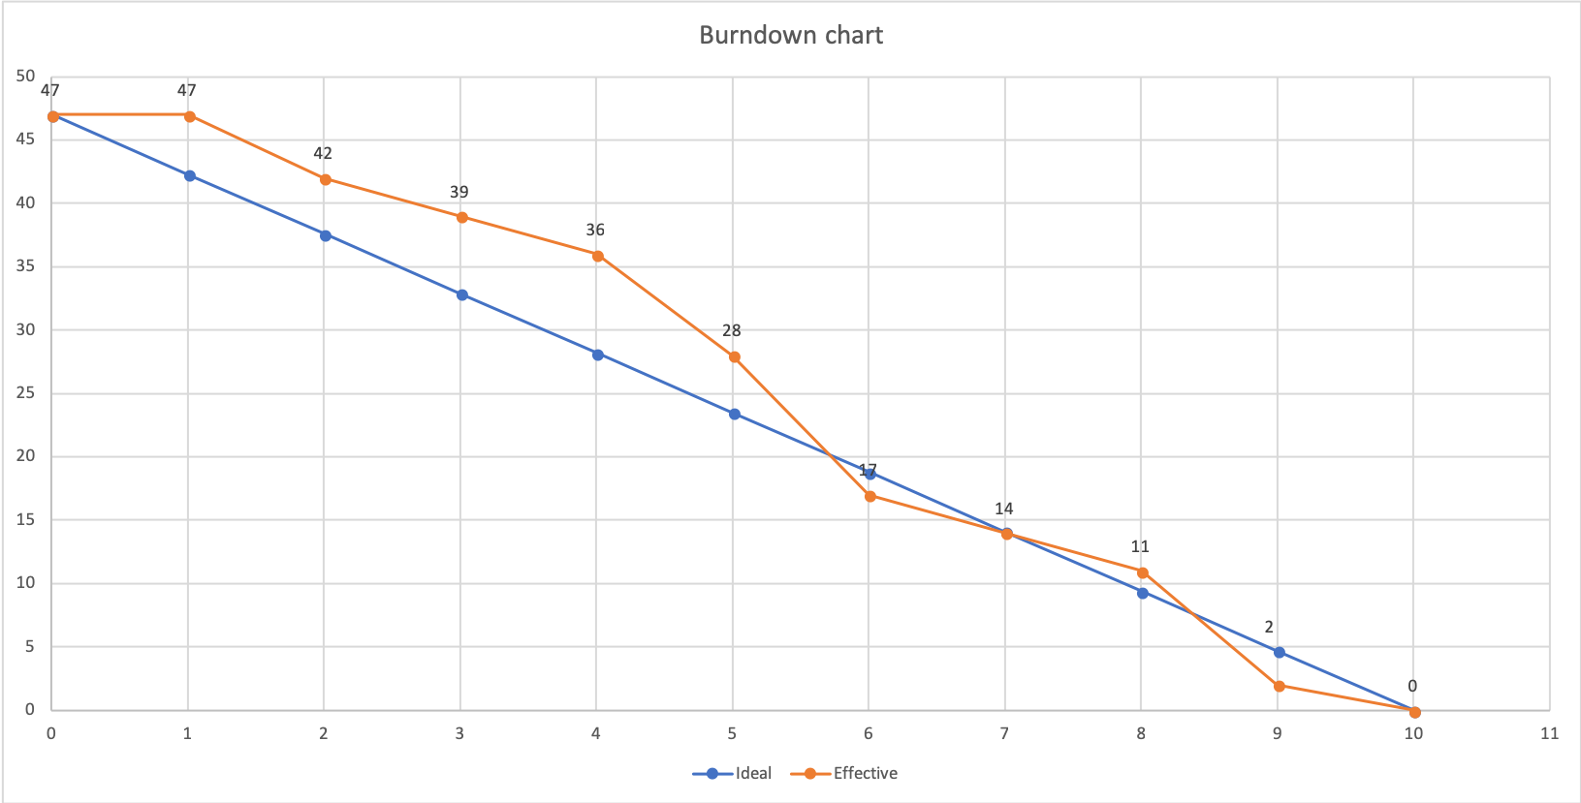
Burndown Chart

Slide 16
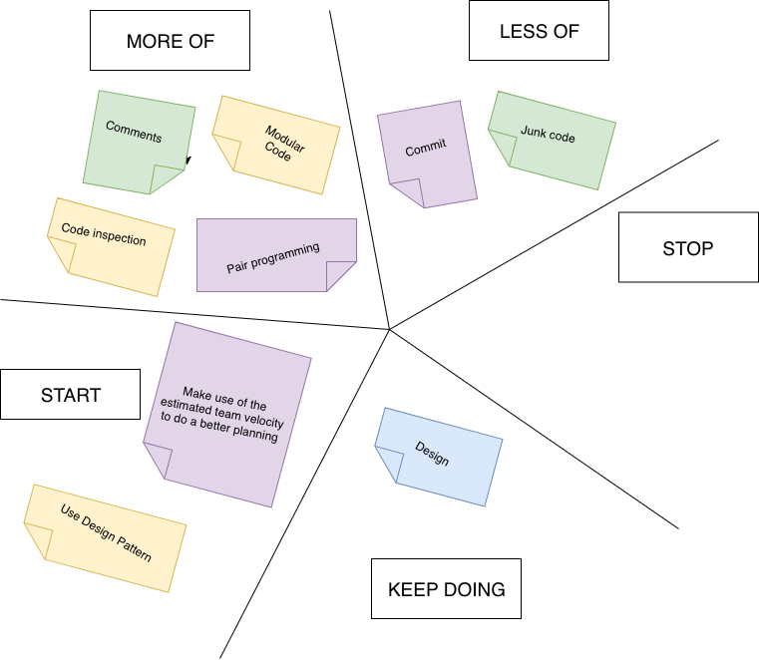
Starfish Retro

Slide 17
Functionalities
The implemented features are:
Movement
Shot
Enemies
Collisions
Random map generator

Slide 18
Movement
Using the WASD controls you can move the character in the scenario.

Slide 19
Shot
Using the directional arrows you can shoot.

Slide 20
Enemies
The objective is to defeat all the enemies inside the scenario.

Slide 21
Collisions
We implemented collisions between the character, the enemies, the shots and the obstacles inside the scenario.

Slide 22
Map Generator
We implemeted a method to generate obstacles randomly.

Slide 23
Thanks for the attention

